Slide 1
DATA SCIENCE
11 WEEK PART TIME COURSE
Week 8 - Natural Language Processing
Wednesday 11th May 2016

Slide 2
AGENDA
Guest Speaker - Ilias Flaounas
Discussion
Natural Language Processing
Case Studies
Techniques for NLP
Lab
Discussion

Slide 3
Task List
Read Natural Language Processing website
Read and be able to explain one use case of the Alchemy API
Download and install NLTK for Python
DATA SCIENCE - Week 8

Slide 4
WHAT IS NATURAL LANGUAGE PROCESSING?
DATA SCIENCE PART TIME COURSE

Slide 5
WHAT IS NATURAL LANGUAGE PROCESSING?
Text is considered to be un-structured data. This means we don’t have nice features we can use as inputs. We will have to construct them using a model or rules we know about language.
Natural Language Processing is the algorithms and processing we program to interpret human language.
It allows us to extract meaning from text as it appears in emails, articles, tweets, journal articles, books, speech, advertisements, etc in the dialect it was created in.

Slide 6
WHY BOTHER WITH NATURAL LANGUAGE PROCESSING?
DATA SCIENCE PART TIME COURSE

Slide 7
???

Slide 8
CASE STUDIES
DATA SCIENCE PART TIME COURSE

Slide 9
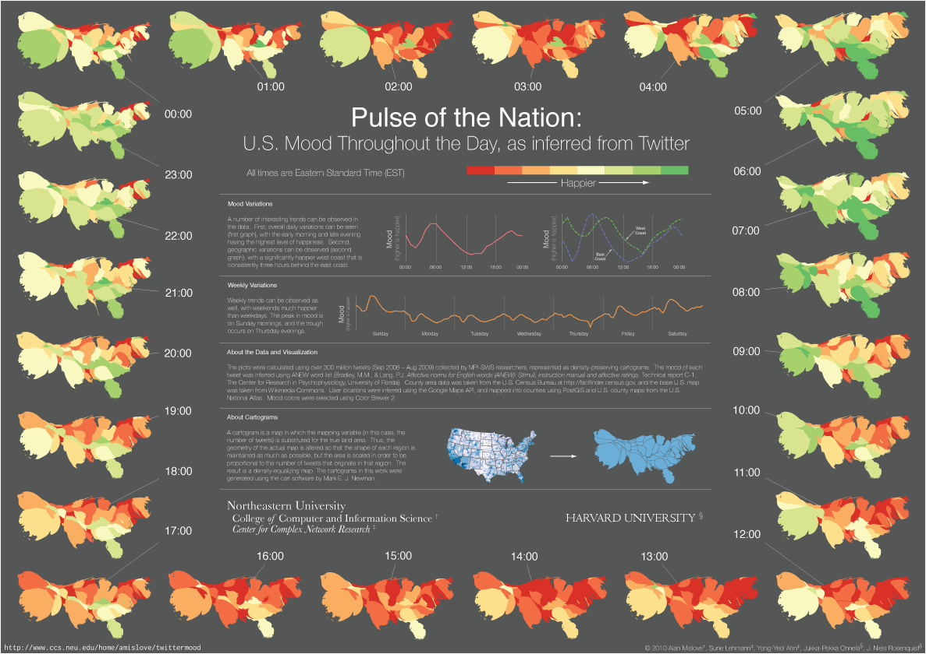

Slide 10
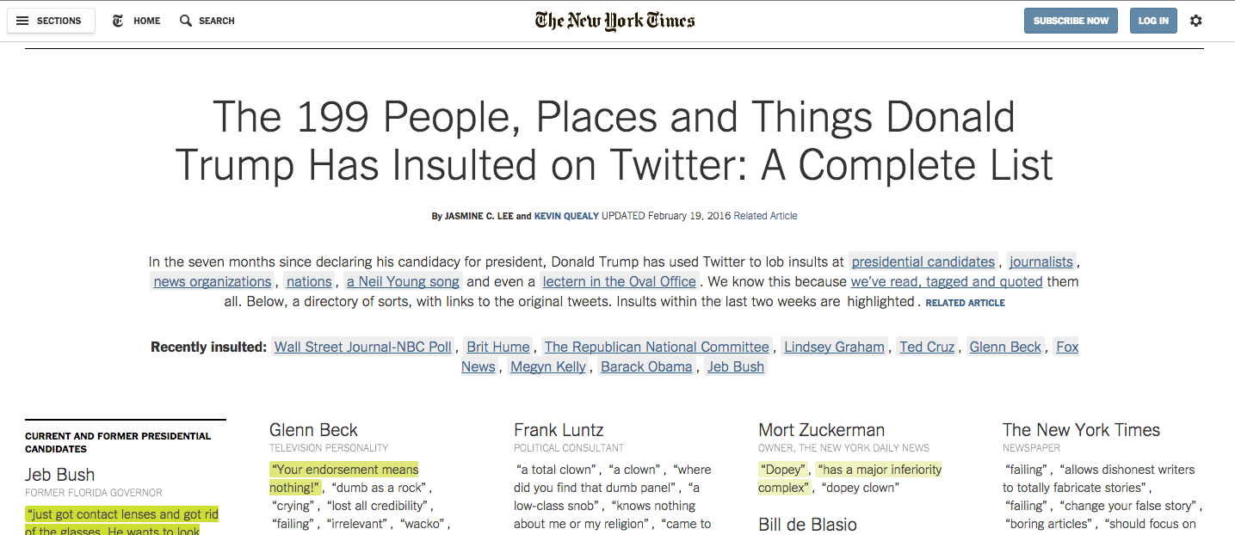

Slide 11

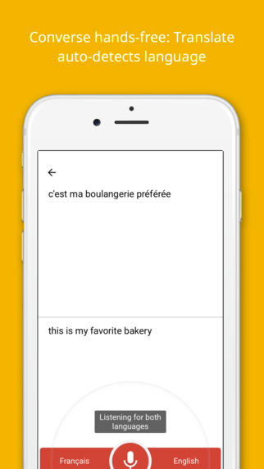
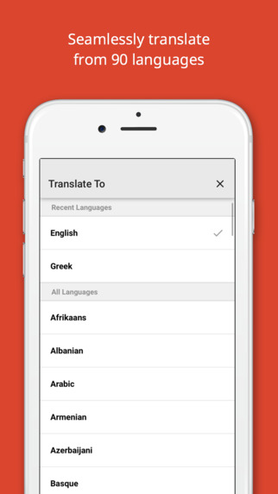

Slide 12
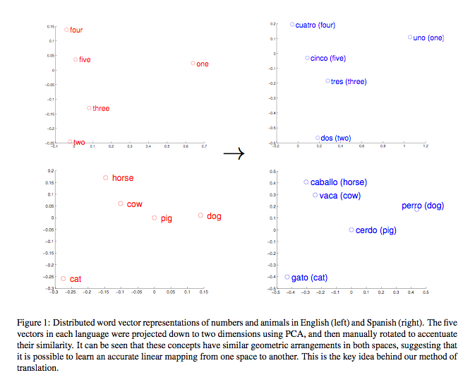

Slide 13
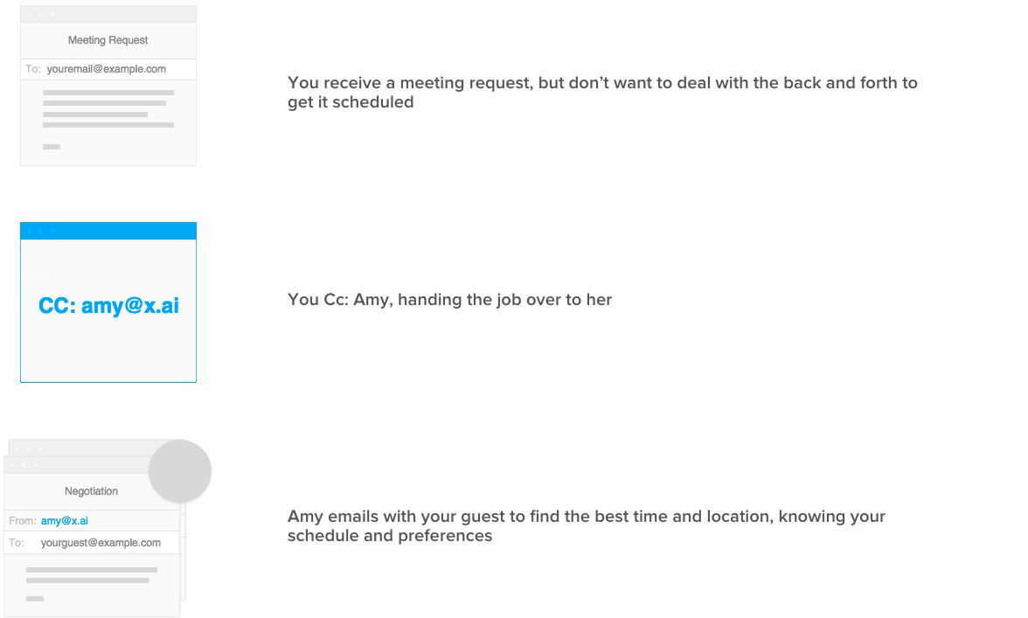

Slide 14
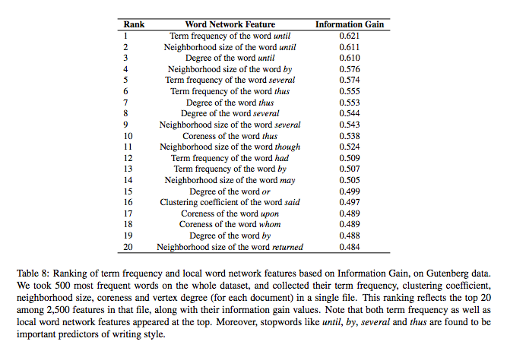

Slide 15
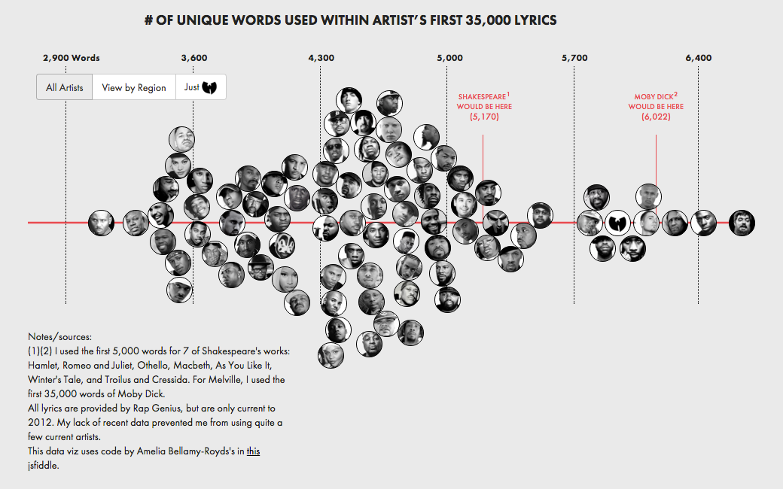

Slide 16
SOME TERMS
Corpus, a large collection of text used for training (e.g. Gutenberg collection or scraping websites)
Part-of-Speech tagging, understanding the nature of a word, is it a verb or a noun?
Lexical Analysis, breaking down the structure of text (ie, Document -> Paragraph -> Sentence -> Words).
Symbolic approach, using rules from language to parse text (can be manually written).
Statistical approach, a sequence labelling problem, we try to infer the properties of a word by the words around it.

Slide 17
HOW COULD WE RUN SENTIMENT ANALYSIS?
DATA SCIENCE PART TIME COURSE

Slide 18
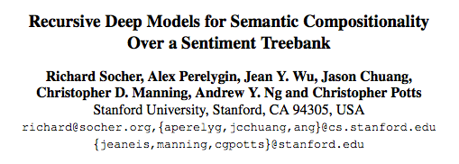
EXAMPLE - SENTIMENT ANALYSIS

Slide 19
EXAMPLE - SENTIMENT ANALYSIS
Most sentiment prediction systems work just by looking at words in isolation, giving positive points for positive words and negative points for negative words and then summing up these points.
The order of words is ignored and important information is lost
It computes the sentiment based on how words compose the meaning of longer phrases. This way, the model is not as easily fooled as previous models

Slide 20
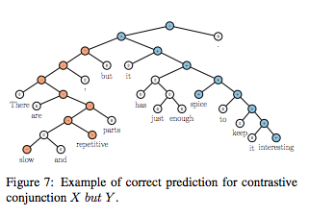
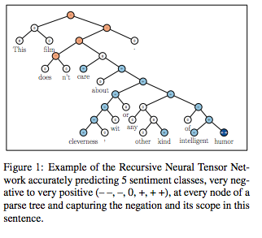
EXAMPLE - SENTIMENT ANALYSIS

Slide 21
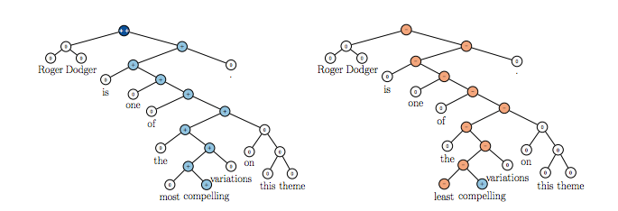
EXAMPLE - SENTIMENT ANALYSIS

Slide 22
TOOLS FOR TEXT ANALYSIS
DATA SCIENCE PART TIME COURSE

Slide 23

WHAT IS TEXT ANALYSIS?
Entity Extraction
Sentiment Analysis
Keyword Extraction
Concept Tagging
Relation Extraction
Taxonomy Classification
Author Extraction
Language Detection
Text Extraction
Microformats Parsing
Feed Detection
Linked Data Support

Slide 24
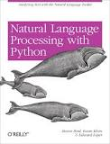
NATURAL LANGUAGE TOOLKIT (NLTK) - Python
NLTK is a leading platform for building Python programs to work with human language data. It provides easy-to-use interfaces to over 50 corpora and lexical resources such as WordNet, along with a suite of text processing libraries for classification, tokenization, stemming, tagging, parsing, and semantic reasoning, wrappers for industrial-strength NLP libraries, and an active discussion forum.

Slide 25
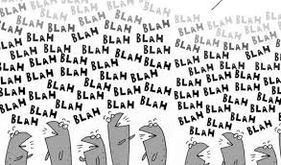
LAB
DATA SCIENCE PART TIME COURSE

Slide 26
DISCUSSION
Review of Last Week
Tasks
DATA SCIENCE - Week 8 Day 2

Slide 27
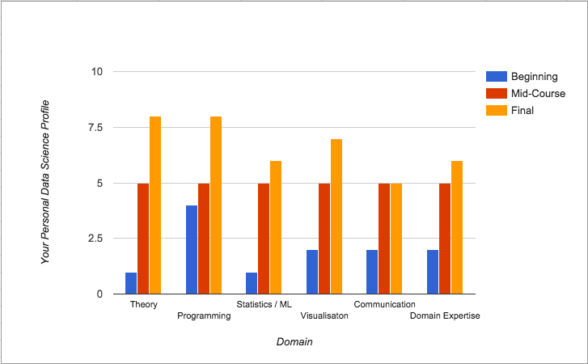
CONTENT PHILOSOPHY

Slide 28
Task List
Read first 2 chapters of Forecasting Principles and Practice https://www.otexts.org/fpp (15 mins)
Download and Install R (10 mins)
Download and Install RStudio (3 mins)
Download the forecast package in R (2 mins)
DATA SCIENCE - Week 8 Day 2

